Slide 1


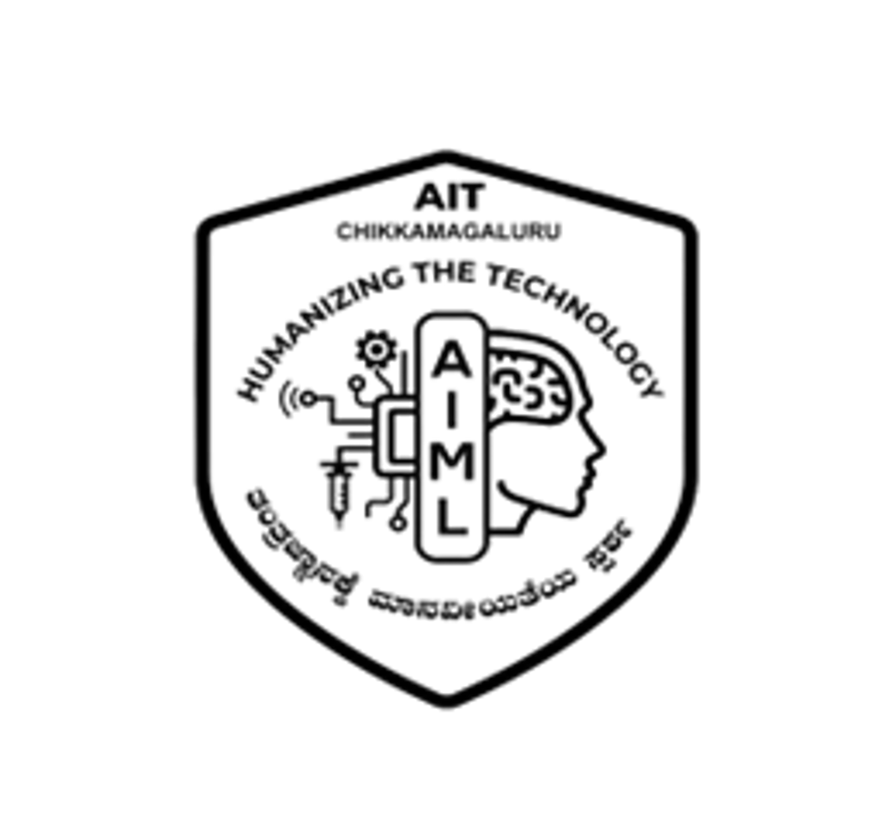
|| Jai Sri Gurudev ||
ADICHUNCHANAGIRI INSTITUTE OF TECHNOLOGY
(Affiliated to Visvesvaraya Technological University, Belagavi | Accredited by NAAC)
Chikkamagaluru – 577 102, Karnataka
DEPARTMENT OF ARTIFICIAL INTELLIGENCE AND MACHINE LEARNING
MINI PROJECT SYNOPSIS PRESENTATION [BAI586]
on
DEVELOPMENT OF AN IOT AND AI-ENABLED ROVER
FOR REAL-TIME CROP HEALTH MONITORING
Academic Year : 2026 – 2027
Under the guidance of :
  Ms. Sathyabhama R, _{B.E., M.Tech}
  Assistant Professor,
  Dept. of AI & ML,
  AIT, Chikkamagaluru.
Presented by :
  Navyashree B H (4AI24AI035),
  Shreyas R S (4AI24AI048),
  Sumaiya Firdoes (4AI24AI051),
  Tejaswini D (4AI24AI055),
  5th Semester,
  Dept. of AI & ML,
  AIT, Chikkamagaluru.

Slide 2
PRESENTATION OUTLINE
Abstract and project context
Project problem and objectives
Related work and project scope
Proposed rover and data flow
Methodology
Hardware and software stack
System architecture
Applications and expected outcomes
Future scope
References

Slide 3
ABSTRACT
Crop diseases, water stress and changing weather can develop before manual inspection notices them.
The proposed rover combines field sensors, an ESP-CAM module and mobile inspection to capture crop and environmental data.
ESP32 controllers transmit readings and images over Wi-Fi to a backend that stores data and runs AI-assisted analysis.
A web and mobile interface presents field status, alerts and irrigation guidance for farmer decision support.

Slide 4
INTRODUCTION
Timely awareness of crop and field conditions supports agricultural productivity and food security.
Manual inspection is labour-intensive, difficult to scale and may miss emerging risks in remote areas.
IoT sensors can measure soil and environmental conditions continuously at low cost.
A mobile rover brings sensors and a camera close to crops, while AI helps interpret images and readings.

Slide 5
PROPOSED SYSTEM OVERVIEW
A mobile rover carries environmental sensors, ultrasonic obstacle sensors and an ESP-CAM module.
ESP32 controllers collect readings, control movement and transmit rover status by Wi-Fi.
Node.js and Express services store data in MongoDB, combine it with weather information and call Python-based analysis.
Agricultural Field
Sensors & ESP-CAM
ESP32 Controller
IoT Communication
Backend Server
Alerts & Insights
Web / Mobile Interface
MongoDB Database
AI / Data Analysis
Figure 1: Overall data flow of the proposed system

Slide 6
PROJECT PROBLEM AND MOTIVATION
Diseases, pests, nutrient deficiencies, water stress and environmental risks can reduce crop productivity.
Periodic manual inspection can delay early response and is difficult across large or inaccessible fields.
Farmers need reliable soil-moisture and weather information before making irrigation decisions.
A field-deployable rover can provide remote observation and continuous data for timely action.

Slide 7
PROBLEM STATEMENT
Agricultural productivity is affected by crop diseases, pest infestations, nutrient deficiencies, water stress, erratic rainfall, droughts, floods, heat waves and other environmental risks.
Conventional monitoring depends largely on periodic manual inspection, which may delay the identification of emerging problems and is difficult to scale across large or remote fields.
There is therefore a need for a field-deployable intelligent monitoring system capable of continuously collecting and analysing crop and environmental information.
This project develops an IoT-enabled, AI-based agricultural rover that integrates embedded sensors, camera-based monitoring, robotics, wireless communication, AI/computer vision and software analytics to provide real-time field information and actionable decision support.

Slide 8
INPUT, PROCESS AND OUTPUT
INPUT
Environmental sensor readings
ESP-CAM field images
External weather / environmental data
PROCESS
Embedded data acquisition
Wireless transmission
Backend processing and storage
AI / computer-vision-assisted analysis
OUTPUT
Real-time field status
Alerts
Decision-support information on web and mobile interfaces

Slide 9
PROJECT OBJECTIVES
Develop a mobile rover platform for field monitoring.
Integrate agricultural and environmental sensors with ESP32 controllers.
Capture crop and field images through the ESP-CAM module.
Transmit rover data to backend services through Wi-Fi using WebSocket or HTTP.
Apply AI and computer vision to support analysis of crop and field conditions.
Provide a web and mobile interface for real-time monitoring, alerts and decision support.

Slide 10
RELATED WORK AND PROJECT GAP
IoT smart agriculture
AI crop monitoring
Wireless sensor networks monitor soil and climate parameters. Many deployments use fixed nodes with limited field coverage and no visual crop information.
Deep learning can identify plant diseases from leaf images. Models often use controlled data and are not connected to live field sensing.
Sensor-based irrigation and robotics
Project gap addressed
Soil moisture sensing supports irrigation while field robots inspect crops. Existing systems often focus on one parameter or one operation.
The proposed prototype combines mobile sensing, field images, environmental data, backend services and farmer-facing alerts in one low-cost monitoring system.

Slide 11
PROJECT SCOPE
Rover-based field inspection with obstacle detection.
Temperature, humidity, soil moisture, rain and flame sensing.
Camera-based crop and field observation.
Wi-Fi communication with real-time web and mobile monitoring.
Historical data storage for field trend review.
AI-assisted identification of crop and field risks.
Soil-moisture and weather-based irrigation guidance.
Alerts for rainfall, heat and fire-related risks.
Autonomous navigation, GPS mapping and automated irrigation remain future enhancements.

Slide 12
METHODOLOGY
Field acquisition and rover control
Communication and storage
Sensors and the ESP-CAM collect field readings and images. ESP32 controllers manage acquisition, motor movement and obstacle detection.
The rover sends sensor values, images and status to Node.js and Express services over Wi-Fi. MongoDB stores readings, image references and alert history.
AI-assisted analysis
Farmer decision support
Python and OpenCV analyze image and sensor information with relevant environmental data to identify crop and field risks.
The dashboard and mobile interface show live conditions, alerts, crop insights and irrigation recommendations for review by farmers and field staff.

Slide 13
HARDWARE COMPONENTS
Sensing and vision
Control and mobility
DHT11 sensor for air temperature and humidity
Soil moisture and rain sensors
Five-channel flame sensor for hazard detection
ESP-CAM module with servo-based positioning
Four ultrasonic sensors for obstacle detection
Two ESP32 development modules
Four BO DC motors and two TB6612FNG motor drivers
Servo motors and buzzer
Rover chassis, wheels and power subsystem
Wireless controller connection through Wi-Fi

Slide 14
SOFTWARE AND TECHNOLOGIES
Embedded and communication
Backend and data
Embedded C/C++ runs on the ESP32 modules for sensor acquisition and motor control. Wi-Fi with WebSocket or HTTP carries real-time rover data.
Node.js and Express receive data and provide APIs. MongoDB stores sensor readings, image references and alert history.
AI and computer vision
Farmer interface
Python, OpenCV and suitable AI/ML models analyze crop images and sensor information to support risk identification.
React and Tailwind CSS provide a responsive dashboard and mobile-friendly interface for live conditions, alerts and historical trends.

Slide 15
SYSTEM ARCHITECTURE
1. Field and rover layer
Crop images, environmental readings and rover status originate from the agricultural field through sensors, ESP-CAM, ESP32 controllers and motor systems.
2. Communication layer
Wi-Fi carries rover data to the backend. Public weather and environmental data adds context for field-condition analysis.
3. Intelligence and application layer
Node.js and Express services coordinate ingestion and APIs. MongoDB stores information. Python-based analysis produces crop insights, irrigation guidance and environmental-risk alerts for the dashboard and mobile interface.

Slide 16
APPLICATIONS AND EXPECTED OUTCOMES
Practical applications
Expected project outcomes
Agricultural field monitoring and remote inspection
Soil moisture monitoring and irrigation decision support
Early awareness of crop and environmental risks
Historical field review for precision-agriculture decisions
Working rover prototype with environmental sensing
IoT communication and MongoDB data management
Camera-based field observation with AI-assisted analysis
Web and mobile monitoring interface with alerts

Slide 17
FUTURE SCOPE
Autonomous navigation and path planning for systematic field coverage.
GPS-based field mapping and a digital representation of the farm.
Advanced disease and pest detection models with stronger edge AI capabilities.
Automated irrigation control based on sensor data and predictions.
Drone integration, multi-rover deployment and multilingual farmer assistance.

Slide 18
REFERENCES
[1] A. Tzounis et al., "Internet of Things in agriculture, recent advances and future challenges," Biosystems Engineering, 2017.
[2] O. Elijah et al., "An overview of Internet of Things and data analytics in agriculture," IEEE IoT Journal, 2018.
[3] S. P. Mohanty, D. P. Hughes and M. Salathé, "Using deep learning for image-based plant disease detection," Frontiers in Plant Science, 2016.
[4] K. P. Ferentinos, "Deep learning models for plant disease detection and diagnosis," Computers and Electronics in Agriculture, 2018.
[5] M. Ayaz et al., "IoT-based smart agriculture: Toward making the fields talk," IEEE Access, 2019.
[6] A. Bechar and C. Vigneault, "Agricultural robots for field operations," Biosystems Engineering, 2016.
[7] W. Shi et al., "Edge computing: Vision and challenges," IEEE IoT Journal, 2016.
[8] S. Wolfert et al., "Big data in smart farming: A review," Agricultural Systems, 2017.
[9] G. Bradski, "The OpenCV Library," Dr. Dobb's Journal of Software Tools, 2000.

Slide 19
THANK YOU
Questions and discussion
Development of an IoT and AI-Enabled Rover for Real-Time Crop Health Monitoring

